Slide 1

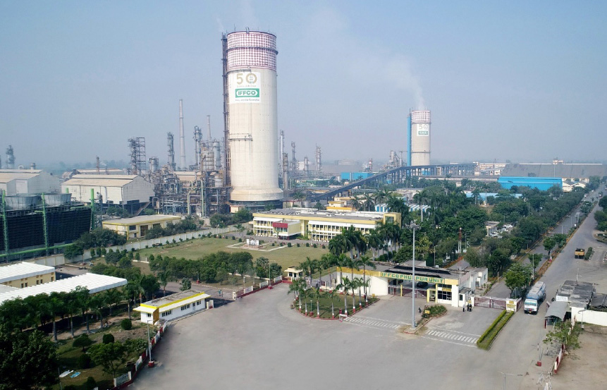

Presented By-
Satvik Singh
22020742017
Faculty Guide-
Dr. Isha Sharma
Project Guide-
Mr. Swayam Prakash Singh
Mr. Rajesh Singh
Mr. Birendra Singh
SIP PRESENTATION

Slide 2
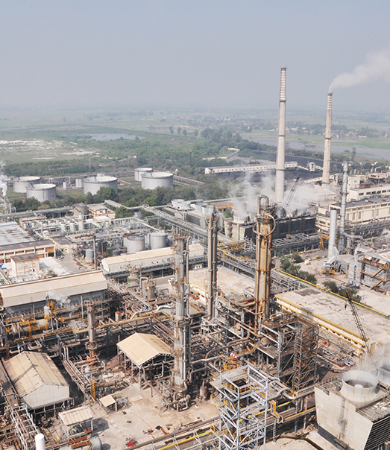
About the Cooperative
IFFCO, short for Indian Farmers Fertilizer Cooperative Limited, is a cooperative society in India that primarily operates in the agriculture sector. It was founded in 1967 and is headquartered in New Delhi, India.
IFFCO plays a significant role in the agricultural industry by manufacturing and marketing a wide range of fertilizers, including urea, DAP (Di-Ammonium Phosphate), NPK (Nitrogen, Phosphorus, and Potassium) fertilizers, and other agricultural chemicals. The cooperative society works with over 36,000 member cooperatives and serves more than 55 million farmers across India.
Apart from fertilizer production and distribution, IFFCO is involved in various other agricultural activities and initiatives. It promotes modern agricultural techniques, provides agricultural education and training, promotes crop insurance, and supports farmers with access to credit and technology. IFFCO also has interests in various sectors like food processing, general insurance, rural telecommunications, and power.
IFFCO is known for its commitment to sustainable and eco-friendly agricultural practices. It emphasizes the importance of balanced fertilizer use and educates farmers about proper fertilizer application to enhance crop productivity and reduce environmental impact.
Overall, IFFCO plays a vital role in supporting Indian farmers and contributing to the agricultural development of the country.
KNOW MORE

Slide 3
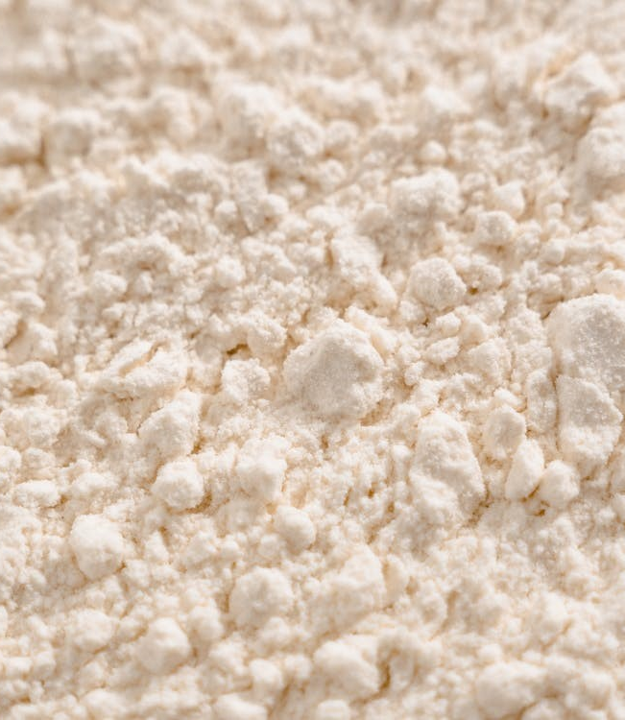
Project 1(Procurement)
Project Name:
Raw Material Inflow Management. (CORDET)
Business Need:
To gain knowledge of bio fertilizers and reduce the cost as much as possible.
Problem Statement:
The major area where cost reduction was possible was inflow of carrier material (talc powder). The project targets the suppliers as well as the supply channel to minimize the cost.
Goal Statement:
1. To analyze the Primary data, identify root cause and gaps
2. To develop solutions from the analysis
3. To record lesson learnt for ongoing and future projects
Project: In Scope: Transportation Channel, Transportation Facilities.
Project: Out Scope: Supplier Capacity, Tax Rates, Price of carrier.

Slide 4
Raw Material Inflow Management
Methodology & Findings
Phase 1
Phase 2
Phase 3
Identification of Gap
Discovering Solution
Solution Validation
High Cost of Production was found as a gap due to high material cost.
The high COP can be reduced by lower material cost which could take place by proper supplier selection taking logistics into account..
Proper validation of solution by giving valid calculations and reasons..

Slide 5


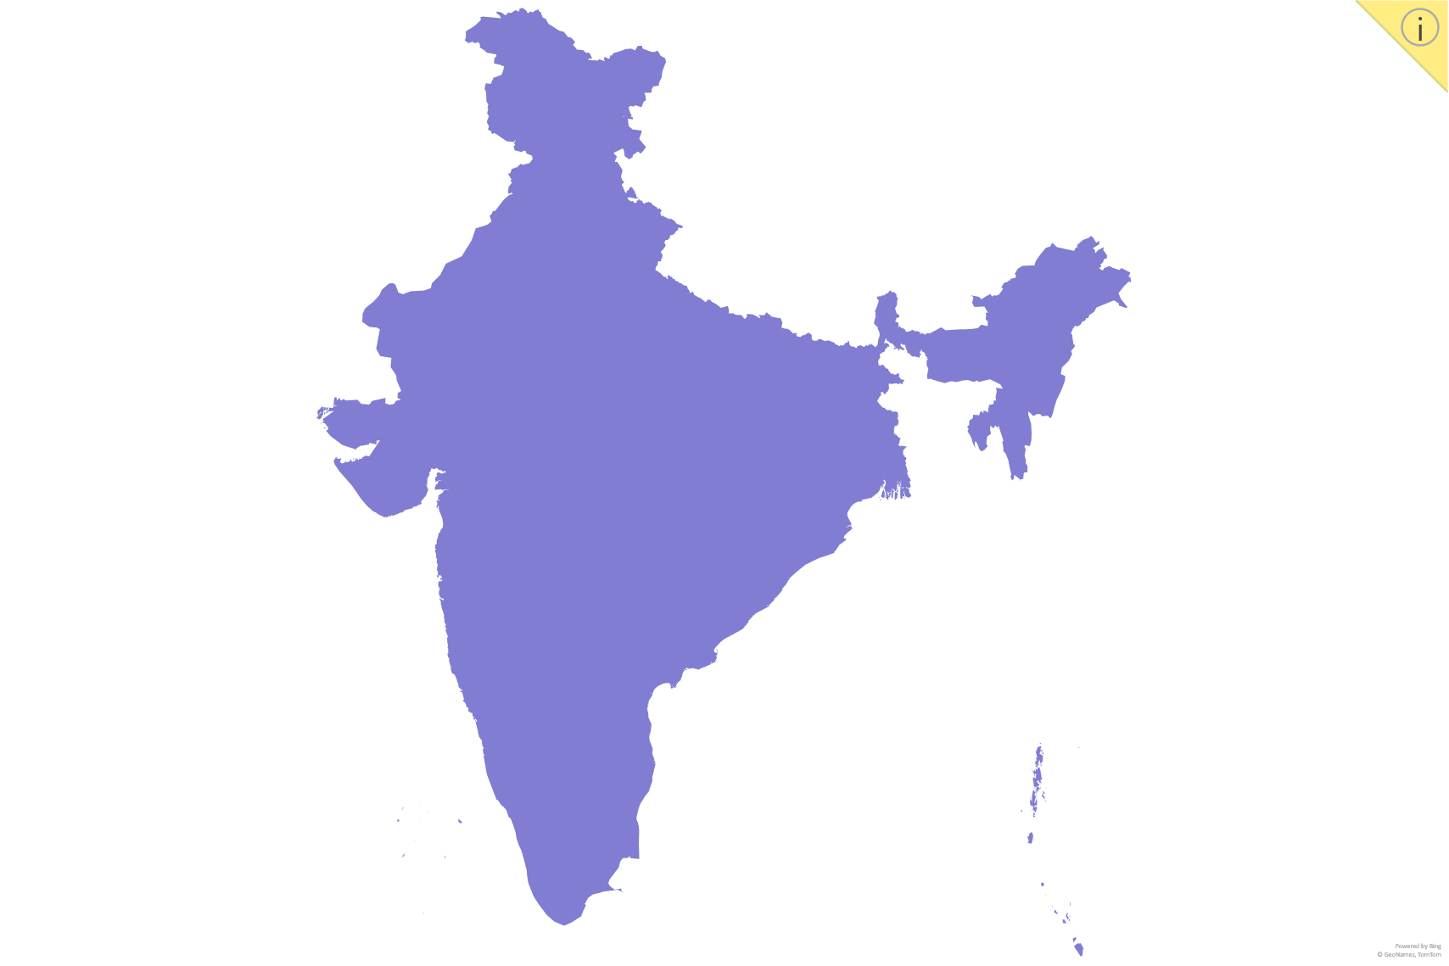
The Solution
Haldwani
Selecting a new Supplier different from local monopolized suppliers. Also ensuring that the supplier has desired capacity and quality.
Two locations were selected
Udaipur, Rajasthan
Haldwani, Uttarakhand
Udaipur was selected for further study as it provided the desired quality in less price.
Phulpur, Allahabad
Udaipur

Slide 6
Solution Validation
Talc Powder : Saving or Loss
COST | (Rs)
Material Cost (Talc Powder) | 225000
Travelling cost (going & returning) | 36800
Toll Charges | 19000
Driver | 1000
Total COP Truck tonnage (tons) | 281800 25
Mileage (kmpl) | 6
Distance (Phulpur to Udaipur), (km) | 1100
Diesel rates (per liter) | 100
Driver salary (per month) | 15000
Maintenance per kg | 0.25
TOTAL COP Per kg (281800/25000) | 12
SAVINGS | (Rs)
Earlier COP per kg | 40
New COP per kg | 12
TOTAL Savings per kg | 28
Cost Areas | Cost/km | Contribution
Fuel | 20.3 | 45.0%
Documentation | 6.8 | 15.0%
Tolls | 4.5 | 10.0%
Driver’s Salary | 4.5 | 10.0%
Maintenance | 4.5 | 10.0%
Others | 2.3 | 5.0%
Loading & Unloading | 1.4 | 3.0%
Tyres | 0.9 | 2.0%
Total | Rs 45.0 | 100.0%

Slide 7
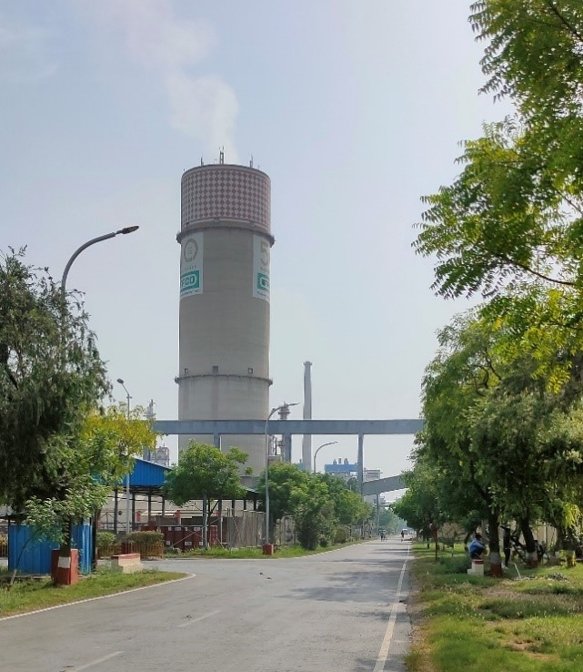
Project 2 (Logistics)
Project Name:
Product Dispatch Management
Business Need:
To gain knowledge of product dispatch management by having on ground sight of the process of dispatching and try to make the process more efficient and effective by reducing as much time as possible.
Problem Statement:
The major area where time reduction was possible was during the cleaning of freight wagons before loading of Product. The project will target to reduce the time and try to make the process more effective.
Goal Statement:
1. To analyze the Primary data, identify root cause and gaps
2. To develop solutions from the analysis
3. To record lesson learnt for ongoing and future projects
Project: In Scope: Transportation Channel, Quantity.
Project: Out Scope: Railway quantity agreements, Rail engine availability.

Slide 8
Product Dispatch Management
Methodology
Phase 1
Phase 2
Observation & Info Gathering
Identification of Gap
A clear understanding of product dispatch process was being taken by the guide.
The information consisted of backend software processes and frontend logistics.
Manual Cleaning Process of wagons before loading was identified as gap area and automation in this process was provided as solution.

Slide 9



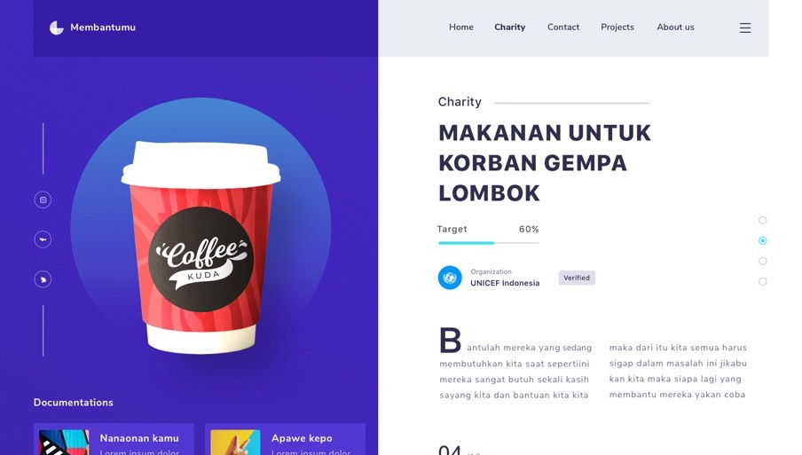
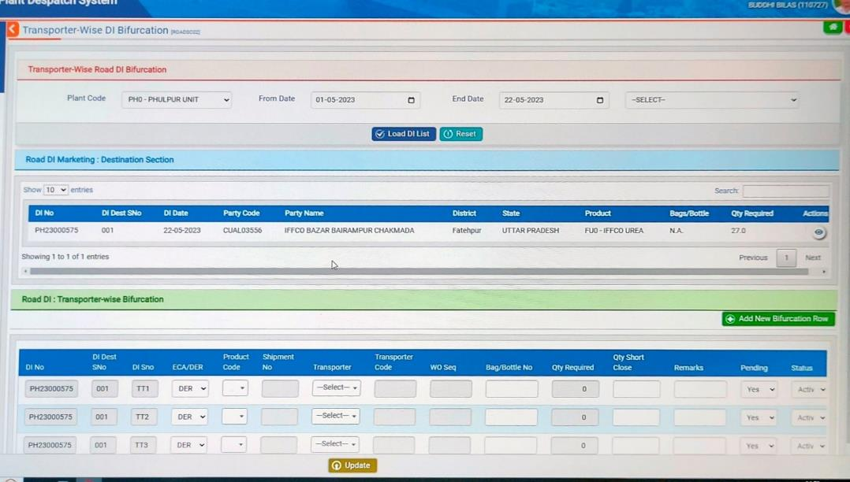


Phase 1
Dashboard
Common Platform
Outsourced
The dispatch (transport outbound) department works on a common platform or dashboard by which all the stakeholders are connected.
The dashboard facility is outsourced by a software-based company of Bareilly, Uttar Pradesh.
Ease of Information
Fulfillment of requests
The dashboard provides all kinds of information and new information is feeded in it every day.
There are requests that are raised by indents by categorically two parties, one Self and the other by marketing team which then goes to warehouse and shop (retailer) respectively.

Slide 10
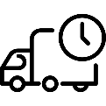

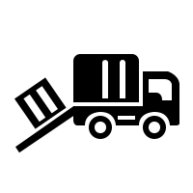

Phase 1
Use case ERP Materials Management
Delay of Delivery
Quantity Management
Loading & Unloading
Failure to reach destination

Slide 11
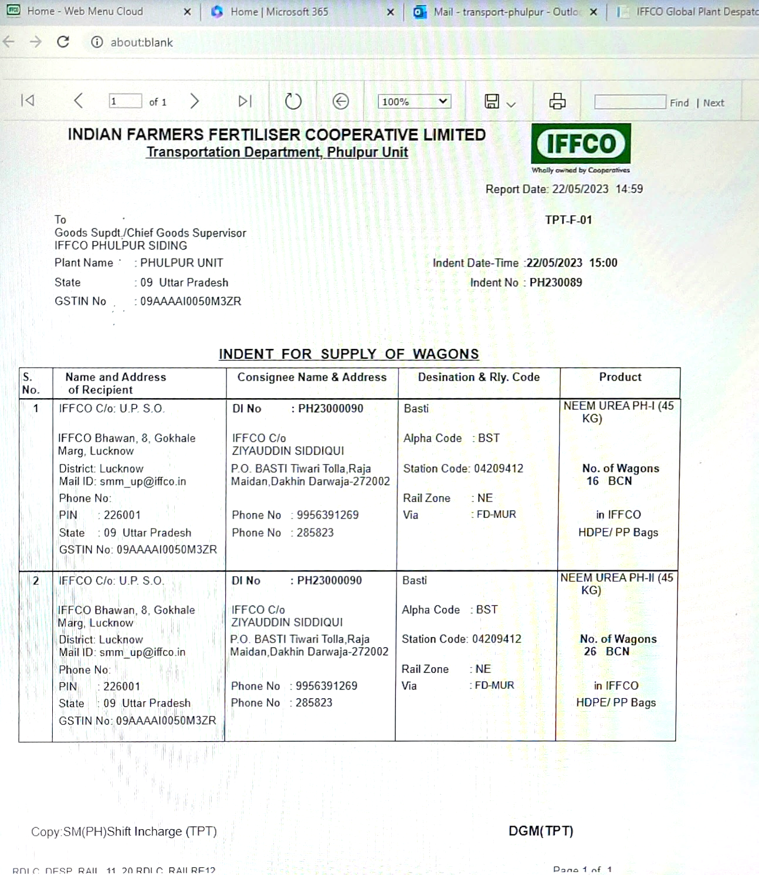
Phase 1
Indent View

Slide 12
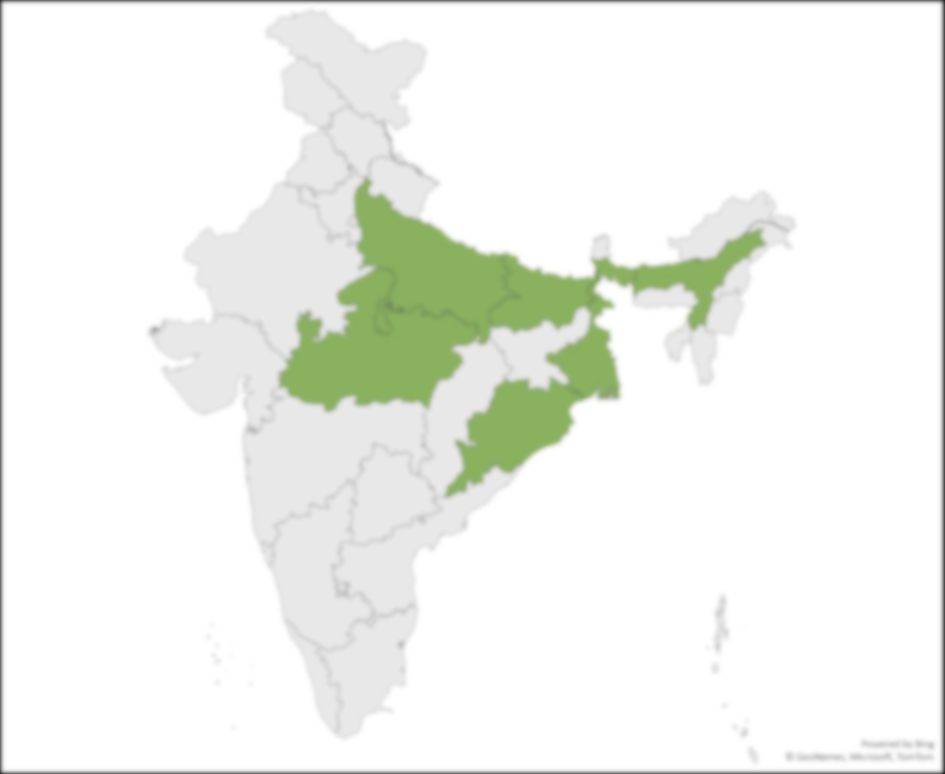
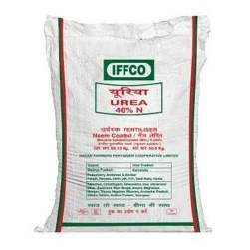
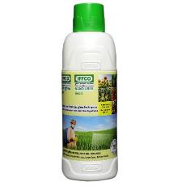
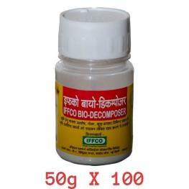
Phase 1
Product and Region Distribution
UREA
Distribution by both Rail & Road
Uttar Pradesh
Madhya Pradesh
Distribution only by rail
West Bengal
Assam
Orissa
Bihar
Export by Rail – Nepal (Nano Fertilizer)
6200-6300 units per day (1000 T – 1200 T)
NANO UREA
Uncertain as it is a new venture.
BIO-DECOMPOSER
Uncertain, it is from CORDET

Slide 13

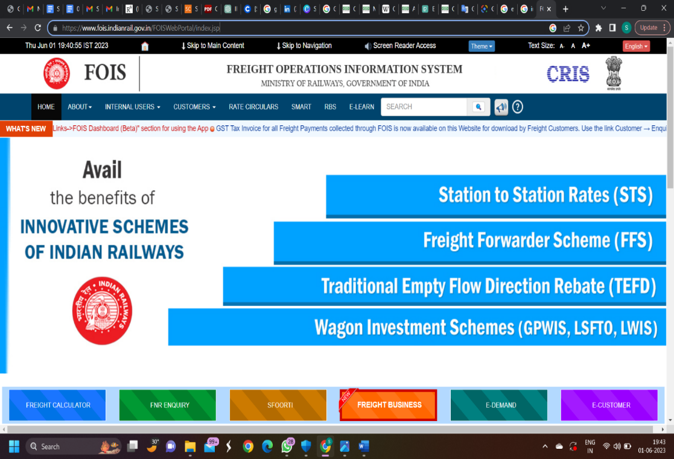
Phase 1
Rail Engine Booking
Requests are usually in the form of wagons when dealing in railway and tons when dealing in trucks.
There are owned as well as rented wagons and there is a booking that is needed to be done for the rail engines required.
This demand for rail engines is generated through the website
https://www.fois.indianrail.gov.in/

Slide 14
Phase 1
Wagon Type-Capacity Matrix
Wagon Type | Chargeable Weight according to Loading Type
 | CC+4 |  | CC+6 |  | CC+8
 | Chargeable weight (in tons) | Sack Count | Chargeable weight (in tons) | Sack Count | Chargeable weight (in tons) | Sack Count
BCN | 59 | 1306 | 61 | 1350 | 61 | 1350
BCNA | 62 | 1372 | 64 | 1418 | 64 | 1418
BCNAHS | 62 | 1372 | 64 | 1418 | 66 | 1430
CC
BCN
BCNA
BCNAHS
Carrying Capacity
Bogie Covered Watertight wagon with cast steel bogie
Bogie Covered Watertight wagon with cast steel bogie & air brake.
Bogie Covered Watertight wagon with cast steel bogie & air brake & heavy load

Slide 15
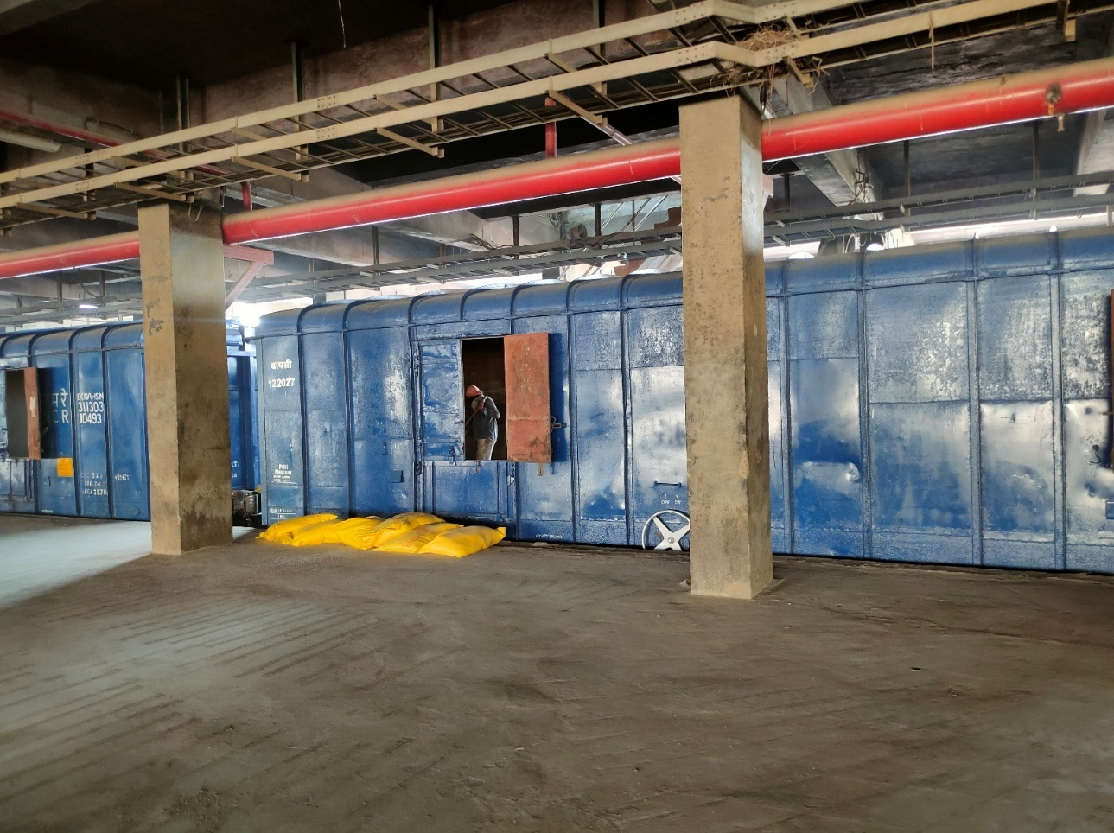
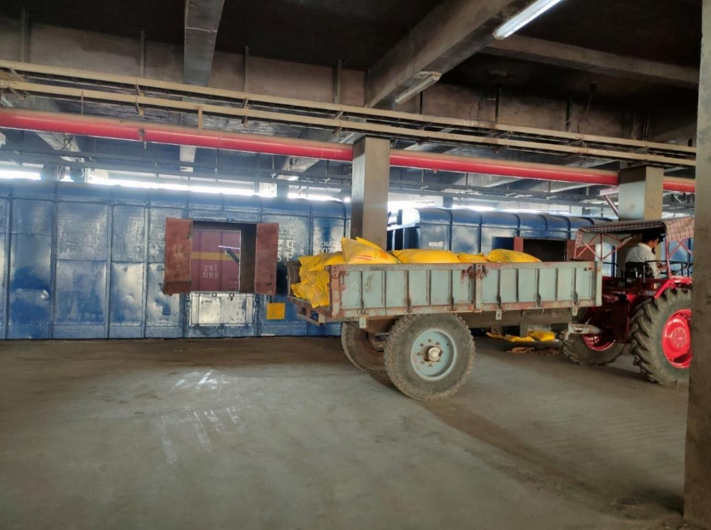
Phase 2
Manual Cleaning of Wagons

Slide 16
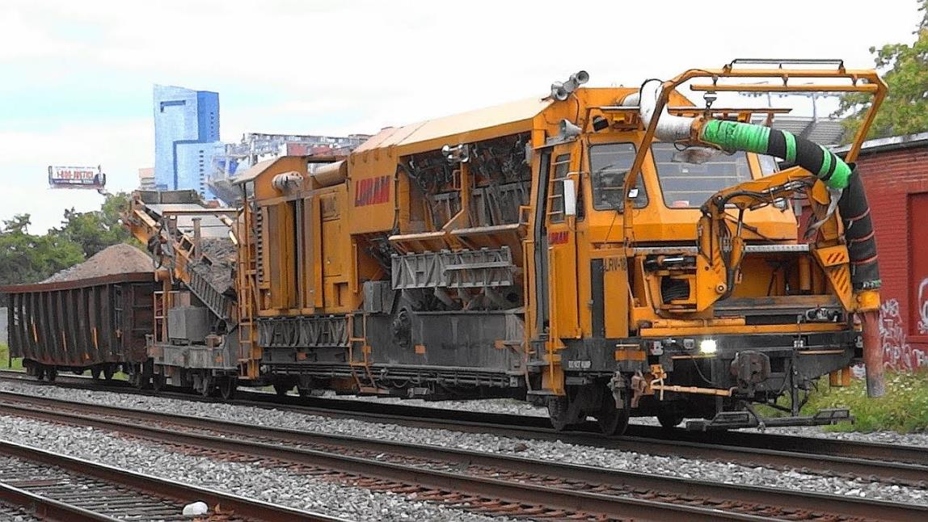
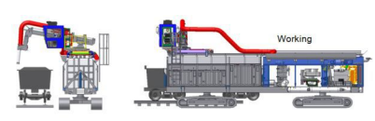
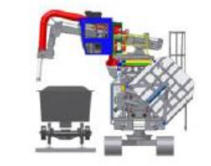
The Solution
Automating the wagon cleaning process will provide effectiveness and quality of work.
For cleaning Ballast Vacuum Cleaner with the modification of crawler mechanism can be used.
A Brazil based company Vale which deals in coal is also currently using the same technology.

Slide 17
Solution Validation
Wagon Cleaning Time
BEFORE
Average time taken by 2 labors to clean one wagon | 20 mins
Loading time of each wagon’s dust | 1 min
Avg number of labors involved (full capacity) | 10
Average No. of wagons (Data taken from Indent) | 42
No of wagons cleaned simultaneously ( in 20 mins ) {(15-1)/2} | 7
Total Time taken to clean 42 wagons {20*6} | 120mins
Total time for the full process including collecting & dumping {120+42} | 162mins
Total time | 2 hrs 42 mins
AFTER
Avg time taken to clean one wagon | 1 min
No. of wagons | 10.0
Average time taken to dump | 20.0
Total time taken {(1*42)+10)} | 52 mins
Total time taken before | 162 mins
Total time saved per train | 110 mins

Slide 18
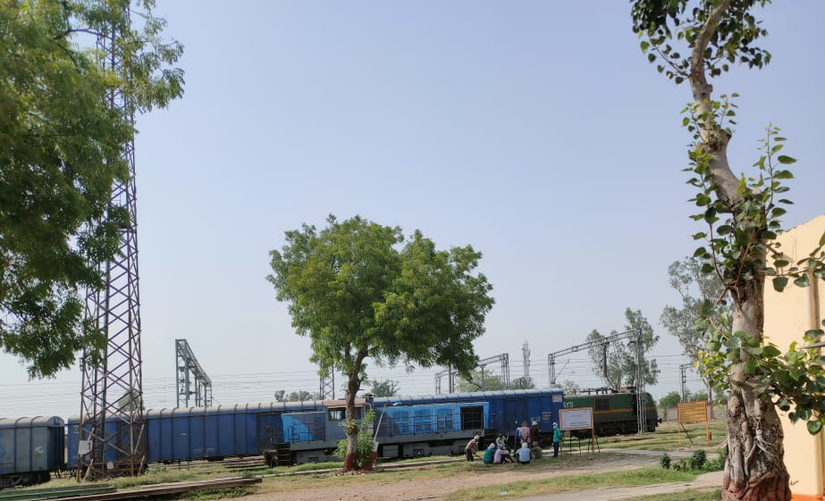
Other Benefits
Work optimization
Less supervision
Better Quality
More synchronization
Only one driver required
Wait time for other trains is reduced.

Slide 19

Managerial Implication & Further Scope of Study
The results and conclusions of the study shows that these institutions can be great opportunities for Agri-Operations Managers who want to contribute in developing & managing robust supply chain channels.
As here the contribution was made by using operations concept:
- Project 1: Reducing Cost - Project 2: By giving plans to reduce time.
Integrating a huge and diverse workforce through one platform and ensuring the network stability
And longevity is a huge task as well as scope for learning as a manager.
Use of new technology like IoT (Internet of Things) & ERP (Enterprise Resource Planning) gives direction to IFFCO to opt and implement more advanced tech in future like
Artificial Intelligence for further smoothening the operations.

Slide 20
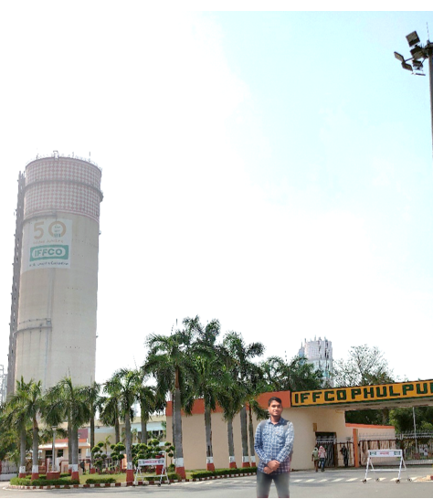
References
https://www.iffco.in/en/corporate
https://www.fois.indianrail.gov.in/FOISWebPortal/index.jsp
https://www.truckindia.co.in/m&hcv-gvw-gcw-payload-unladen-weight-commercial-vehicle-category-english.html
https://en.wikipedia.org/wiki/Cooperative#:~:text=A%20cooperative%20(also%20known%20as,and%20democratically%2Dcontrolled%20enterprise%22.
https://rdso.indianrailways.gov.in/uploads/files/know%20indian%20railways%20wagon.pdf
https://www.sap.com/india/products/erp/what-is-erp.html
https://loram.com/wp-content/uploads/wagon-cleaning-vale-oliveira.pdf
KNOW MORE

